Slide 1
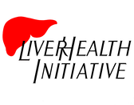
Prevention Through Education
Outreach Training Session

Slide 2
About us
The Liver Health Initiative is a 501(c)(3) organization dedicated to promoting healthy food and lifestyle behaviors and prevention of liver related diseases through multifaceted liver health education programs.
Thelma King Thiel, RN, BA - Co-founder
Malki Manukulasuriya – Co-founder

Slide 3
The problem
Obesity
Hepatitis
Drug & Alcohol Misuse/Abuse
Opioid Epidemic, Start Talking Maryland Act
Diabetes
High Cholesterol
Fatty Liver
Atherosclerosis
*All liver related and preventable

Slide 4
The approach
Liver Health Education – Missing Link
Developing healthy behaviors
Empowering children
Avoid liver damaging activities
Building self esteem
Act on what they’ve learned

Slide 5
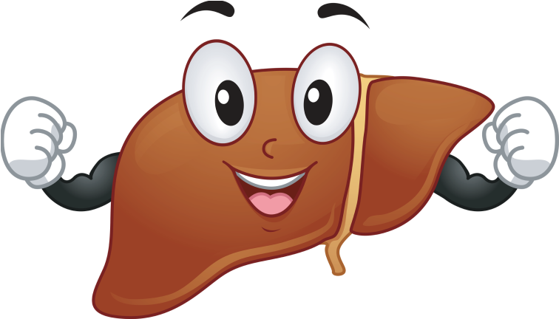
About the Liver
Size of a football, tucked up under the right side of the ribs for protection
Functions
Energy
Digestion
Clotting Factors
Immune Factors
Hormones
Bone and Muscle Development
Controls Cholesterol

Slide 6
Methods
Quick and easy, relatable messages
Story-telling approach
“apple-energy”
“man with a crowbar”
Memorable analogies
“engine in your car”
AEIOU vowels
Santa Claus’s Helpers
Teaching Tools
Olivia & Oliver: Meet Your Miraculous Liver Coloring Book
Get To Know Me Brochure
Numerous DVDs
Curriculum Teaching Guidelines
Motivational Sound Bites

Slide 7
Liver Functions – energy
Gives you energy to get out of bed in the morning
Bile helps you absorb nutrients

Slide 8
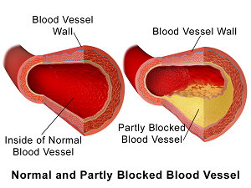
Liver Functions – Controls Cholesterol
Liver is responsible for production and excretion
of cholesterol

Slide 9
Liver Functions – Clotting Factors
Liver produces “sticky” clotting factors.
Ensures that you don’t bleed out from minor scrapes.

Slide 10
Liver Functions – Bile production
2 main functions :
Detergent that breaks up fats, helping you absorb nutrients.
Removes toxins from your body as waste products.

Slide 11
Liver Functions – Immune Factors
Immune factors protect
you from reinfection.
Also protect you from other
germs and viruses you come
into contact with.

Slide 12
Liver Functions – Hormones
Produces hormones that
aid in:
Stimulating body growth
Regulating blood pressure
Cell maintenance

Slide 13
Highlights
Your liver, is your guardian angel and internal chemical power plant
Your liver cells are your employees in your power plant, the microchips in your cell phone.
Everything you eat, breath, and absorb through your skin must be refined by your liver

Slide 14
Videos
Live – R – Die:
https://www.youtube.com/watch?v=3fa0rDF7zwM
Give Your Liver A Break:
https://www.youtube.com/watch?v=QJjs60jsVyE

Slide 15
Things that harm your liver
Drugs, alcohol, hepatitis viruses, and excesses of unhealthy foods.
Continued assault causes
scar tissue buildup
or cirrhosis.
If you have too many dead liver cells and too few healthy ones, your liver will shut down.

Slide 16
All drugs are chemicals
All drugs are made up of chemicals.
Whether over-the-counter,
or illicit, mixing and matching
drugs can kill liver cells.
Be mindful of overwhelming
your hardworking liver cells.

Slide 17
Your liver is your engine
=
Be mindful of what you are feeding your body’s engine.
Excess carbohydrates and sugars are stored as fats
in the liver and other areas of the body.

Slide 18
Consider Obesity
1 in 6 US citizens has a fatty liver, a precursor
to cirrhosis, and possibly liver cancer.
Warning: If your waist measure is:
>35 inches for Women
>40 inches for Men
It’s up to you to take charge of what
you feed your engine.

Slide 19
alcohol
The liver can effectively process:
2 drinks/day for Men
1 drink/day for Women
Drinking excessively can overwhelm
liver cells, and cause toxins to build
up in the body.

Slide 20
your skin
Breaks in the skin can allow germs and viruses to
travel to your liver.
Warning: IV drugs, tattoos, body piercings,
razors, and even manicures can leave you vulnerable
to hepatitis and other viruses.

Slide 21
Breathing in Toxins
Fumes of any kind can cause liver
damage (smoke, detergents,
paint thinner, disinfectants, aerosol
sprays etc.)
Over time, the combination of toxins
breathed in can cause liver damage,
or further damage an already compromised liver.

Slide 22
Final Takeaways
1. Your liver processes everything you eat, breathe,
and absorb through your skin.
2. It aids in digestion, nutrient absorption, creation of
immune factors, clotting factors, and hormones.
3. Liver cell death is called cirrhosis – can lead to cancer.
4. Your liver is a non-complaining organ – it can’t warn
you of trouble until the damage is far advanced
5. It is up to you to take responsibility for your liver’s
health and your life itself.

Slide 23
Next Steps
Ending Questionnaire
Target Audiences to Reach?
Suggestions & Ideas?
www.Liver-Health.org

